Slide 1
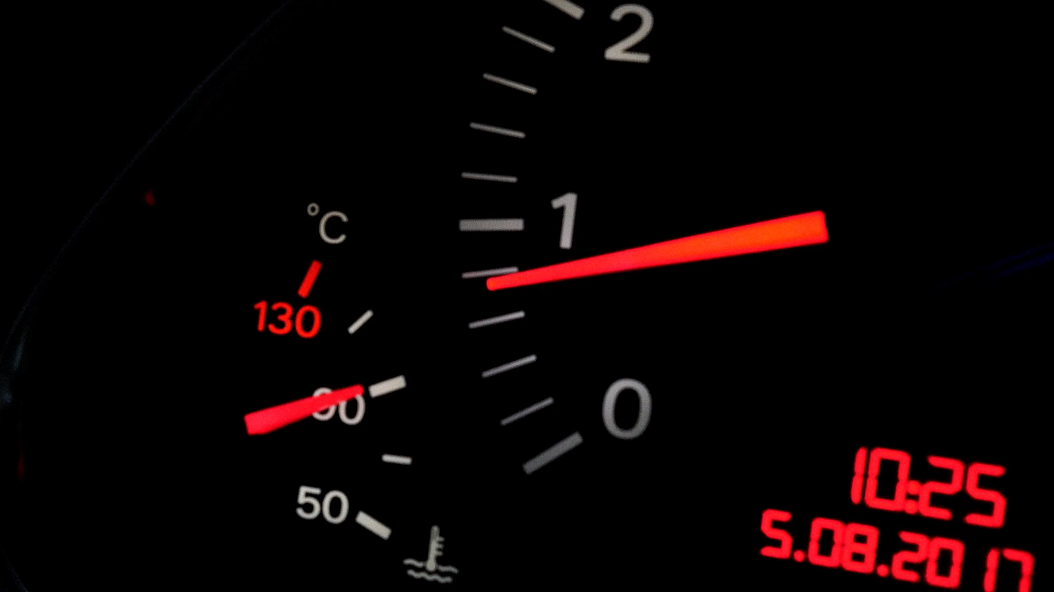
ROAD ACCIDENT DASHBOARD
An Advance Excel Self project by -
Manoneet Gawali
manoneetag23@iitk.ac.in
MTech Student at IIT Kanpur

Slide 2
Requirements
Primary KPI – Total Causalities taken place after the accident for Year 2021 and 2022
Primary KPI’s – Total Causalities and percentage of total with respect to accident severity and maximum causalities by type of vehicle for Year 2021 and 2022
Secondary KPI’s – Total causalities with respect to vehicle type
Monthly trend showing causalities for current and previous year
Maximum causalities by Road type
Distribution of total causalities by road surface
Relation between causalities by Area/Location & Day/Night

Slide 3

Possible Stakeholders
Ministry of Transport
Road Transport Department
Police Force
Emergency Service Department
Road safety Corps
Transport Operators
Traffic Management Agencies
Public
Media

Slide 4
Meta Data
File Extension : .xlsx
No of Rows : 3.07 Million
No of Fields : 21
Data Size : 36.144 MB

Slide 5
Type Of Causalities
Total Casualties : 417883
Serious Causalities : 59312
Slight Causalities : 351436
Fatal Causalities : 7135

Slide 6
Vehicle Type Causalities
Car : 333485
Truck/Van : 33472
Bus : 12798
Bike/Motorcycle : 33672
Tractors /Agri. Vehicles : 1032
Others : 3424

Slide 7

Location & Light Conditions
Urban Area – 255.9K
Rural – 162.0K
Causalities are More in case of Urban Area.
Daylight – 304.96K
Dark – 112.92K
Causalities Occur More frequent in Daylight

Slide 8

Road Conditions
Dry : 27944
Wet : 11526
Snow/ice : 2278
Others: 39
Data represents that accidents are more prone in Dry surface area.

Slide 9
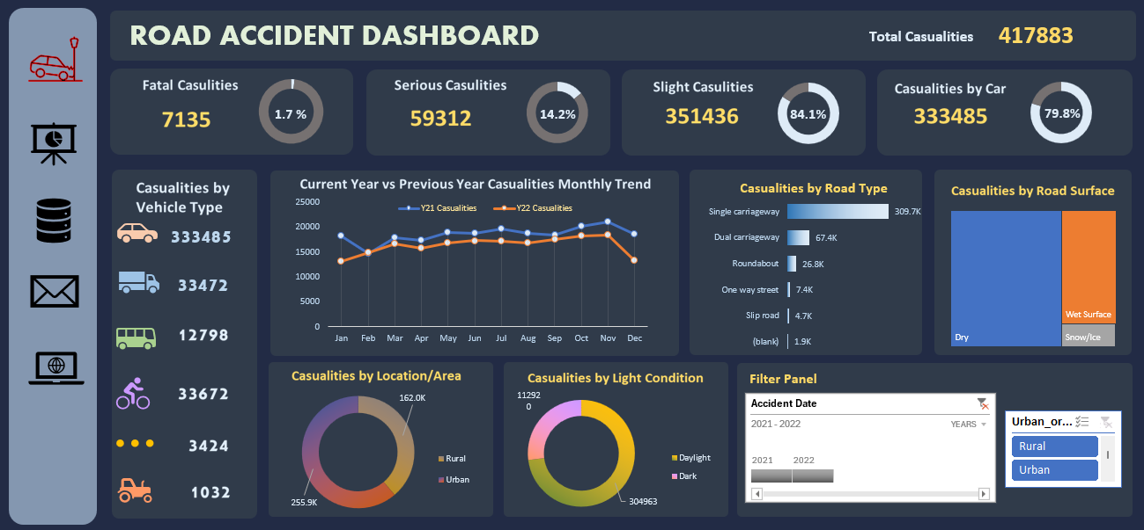
Dashboard

Slide 10
Conclusion from Analysis
More Prone when :
Vehicle is Car
Location is Urban
Occur in Daylight
On Single carriageway
On Dry road.
Occurred more in Year 2021 in November
Less Prone when :
Vehicle is Agricultural type like Tractors
Location is Rural
Occur in Dark
On Slip Road
Occurs in Snow and Non-Metallic Roads
Occurred less in Year 2021 in December

